Slide 1
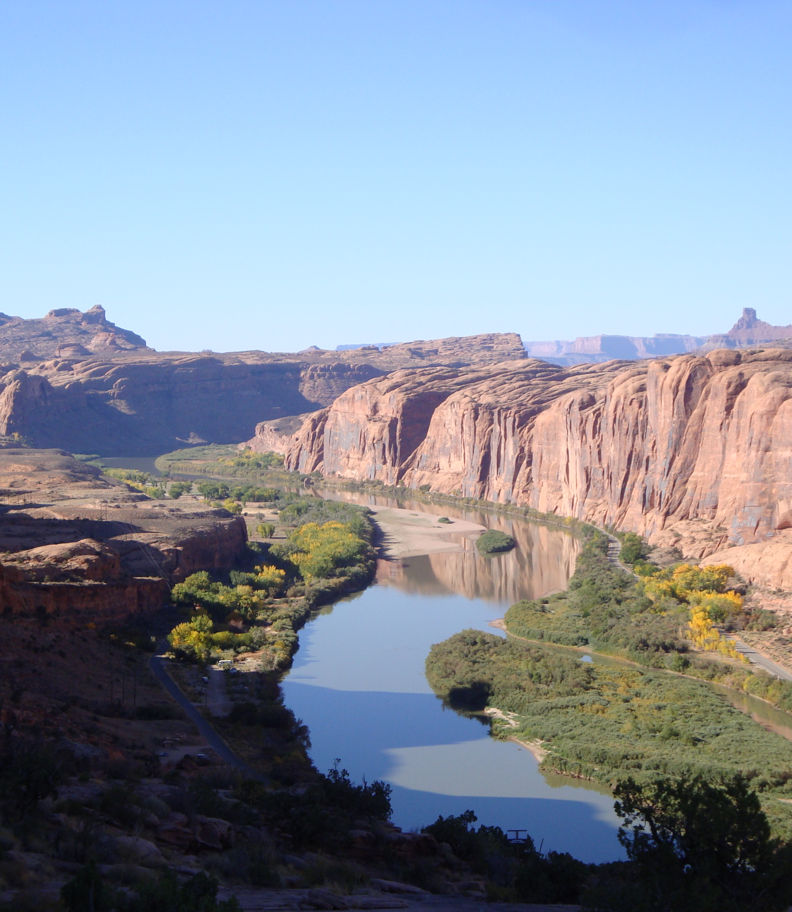
USGS Data on Streamflow Drought in the Colorado River Basin
Matthew Thompson & Ali Dadkhah

Slide 2
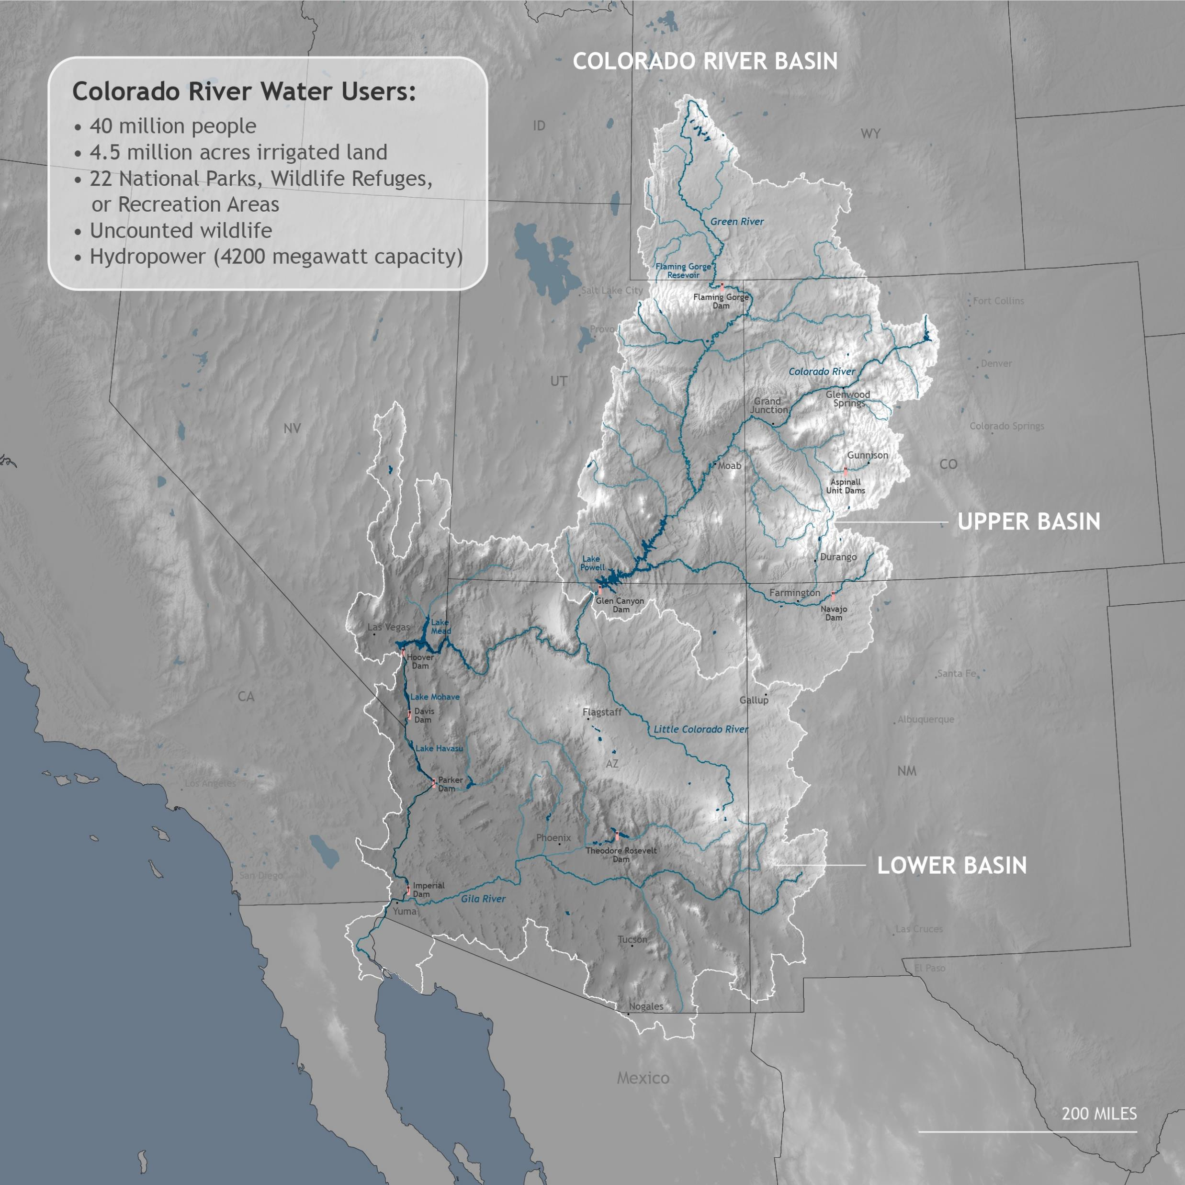
Data Overview
Streamflow Drought Data (1980-present) for 425 gauges:
Study area/gauge locations
Drought events
Annual min flow at each gauge
Streamflow percentiles for each gauge

Slide 3
Project goal(s)
Cluster Semivariograms for:
Min daily temperature
Daily precipitation
Medium depth soil moisture (10-40cm)
Snow water equivalent (SWE)
Daily streamflow percentile
Cluster annual streamflow 20% threshold
And see if we can find anything interesting

Slide 4
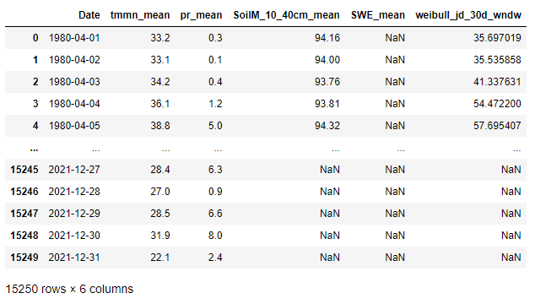
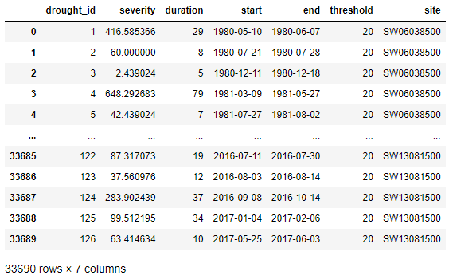
Process of creating a temporal semivariogram

Slide 5
Clustered Timeseries

Slide 6
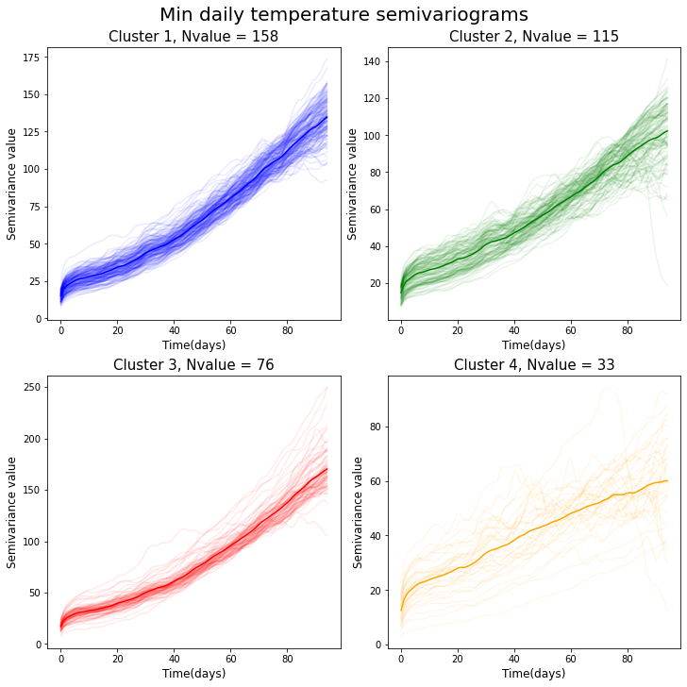
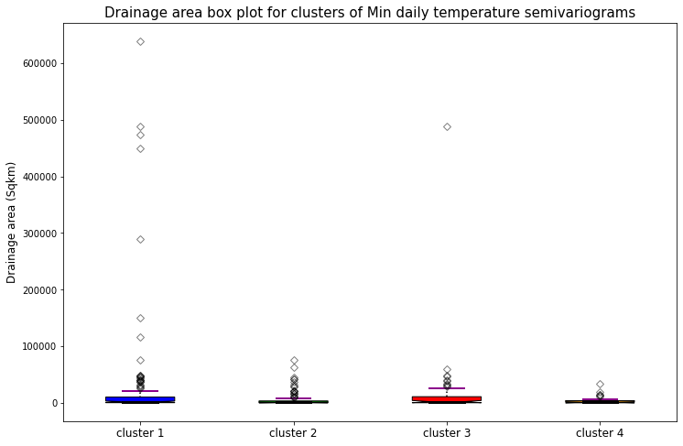
Min daily temperature

Slide 7
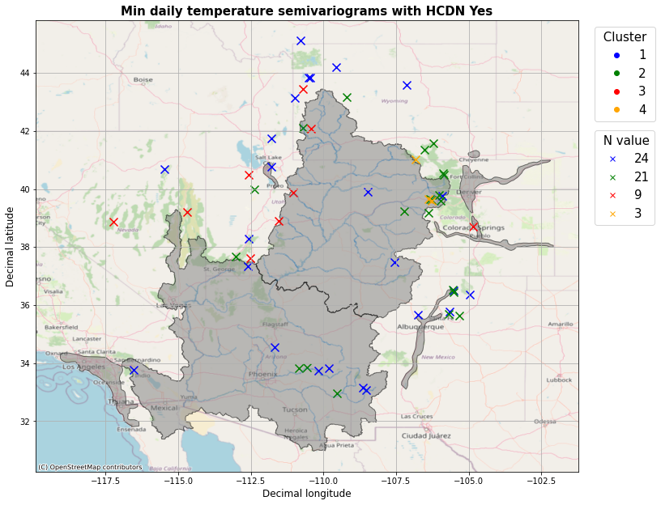

Slide 8
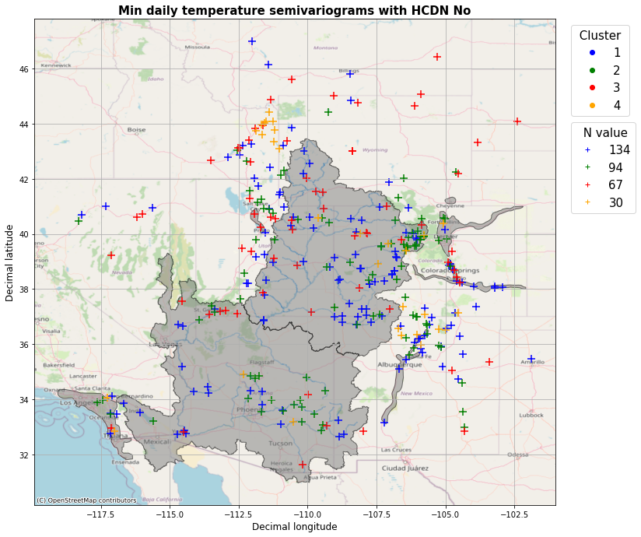

Slide 9
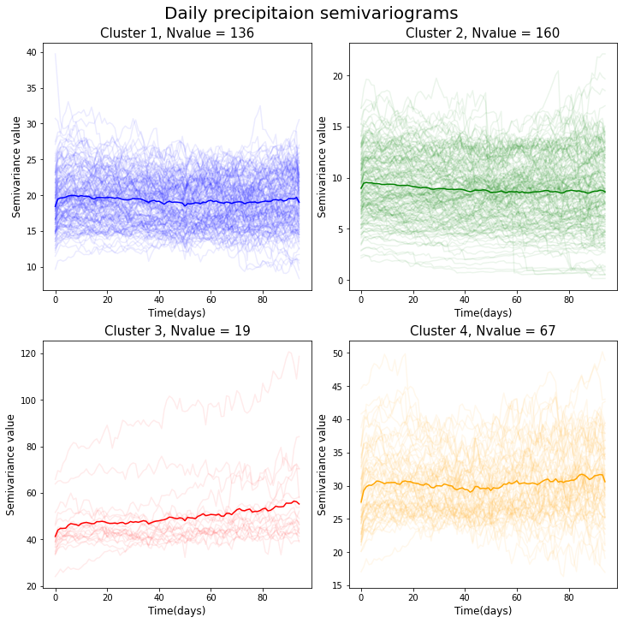
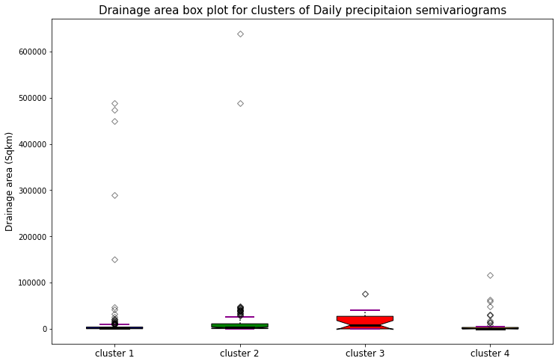
Daily precipitation

Slide 10
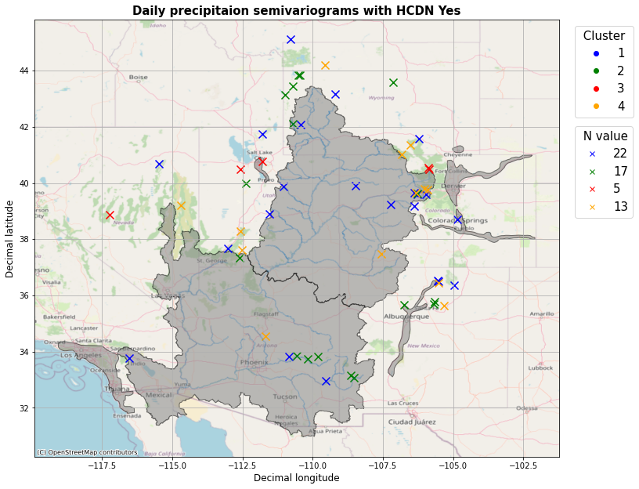

Slide 11
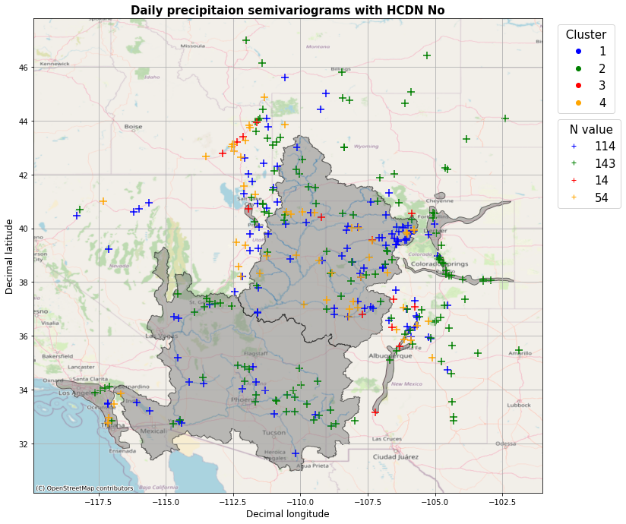

Slide 12
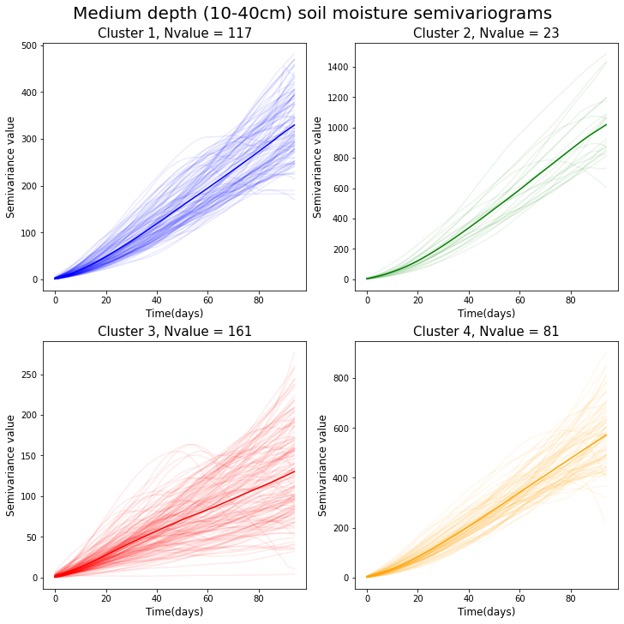
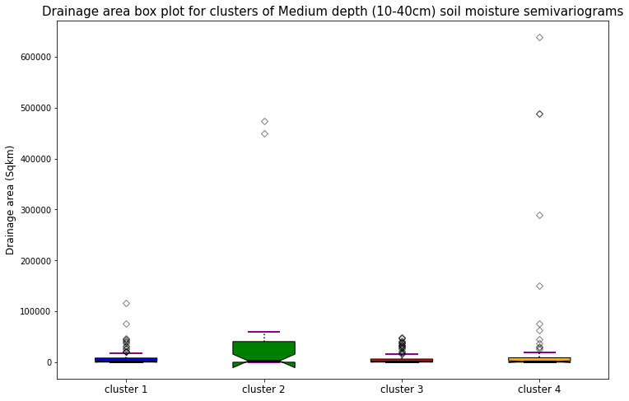
Medium depth soil moisture (10-40cm)

Slide 13
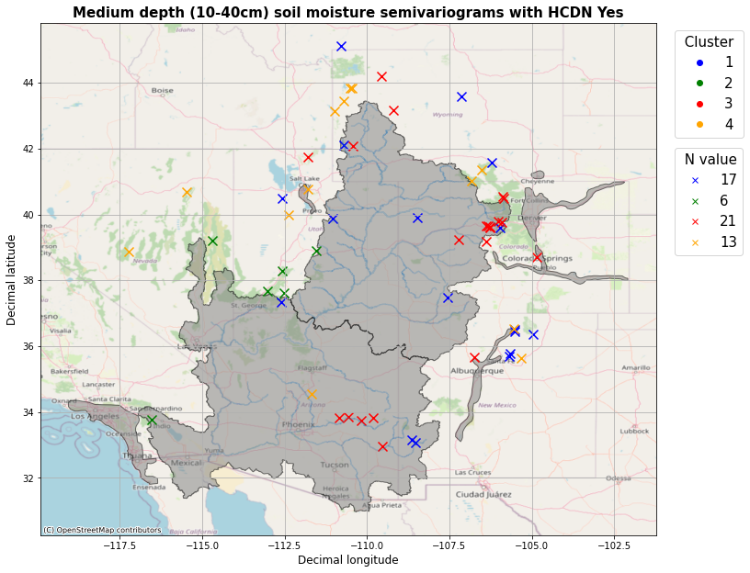

Slide 14
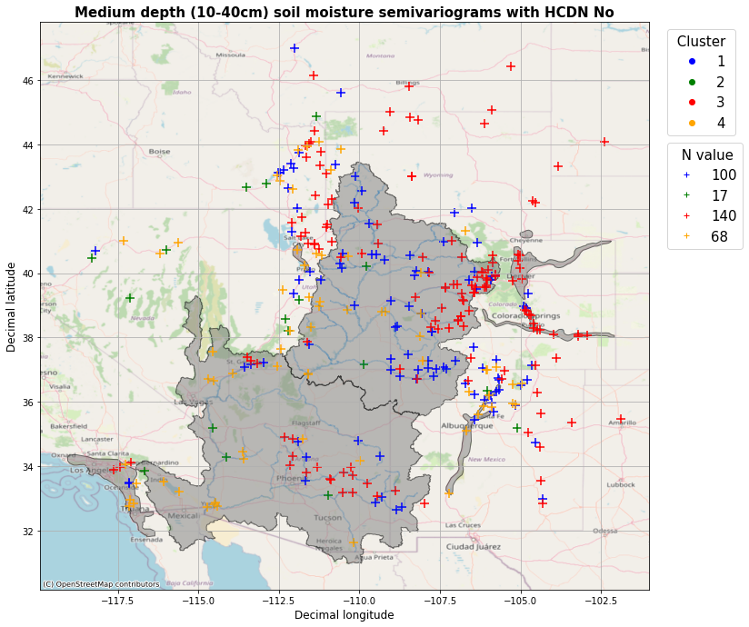

Slide 15
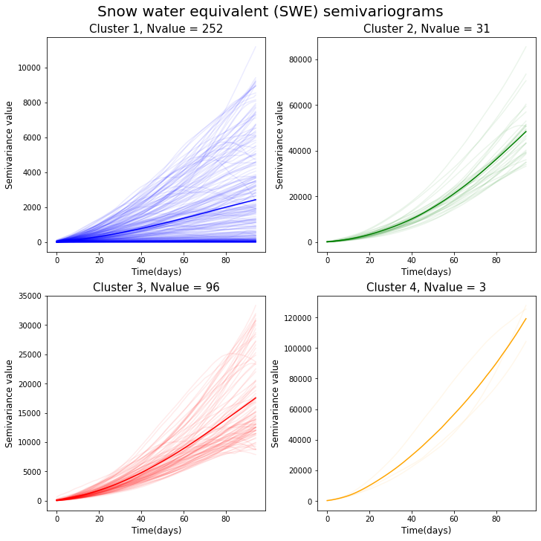
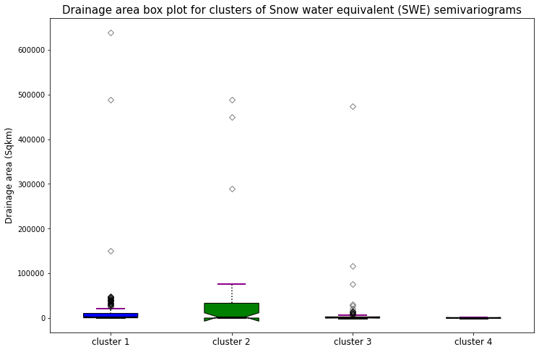
Snow water equivalent (SWE)

Slide 16
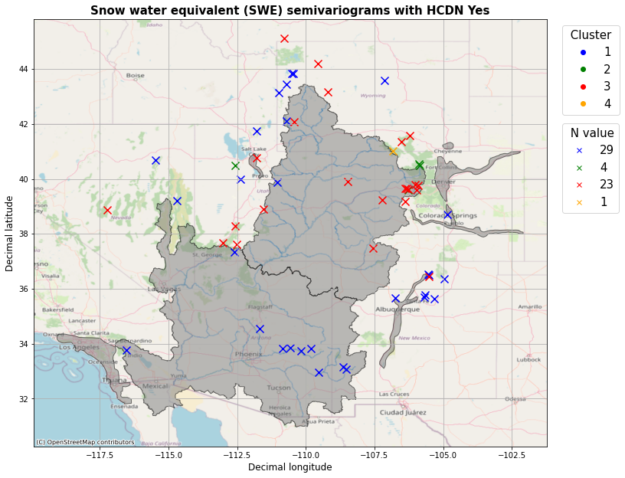

Slide 17
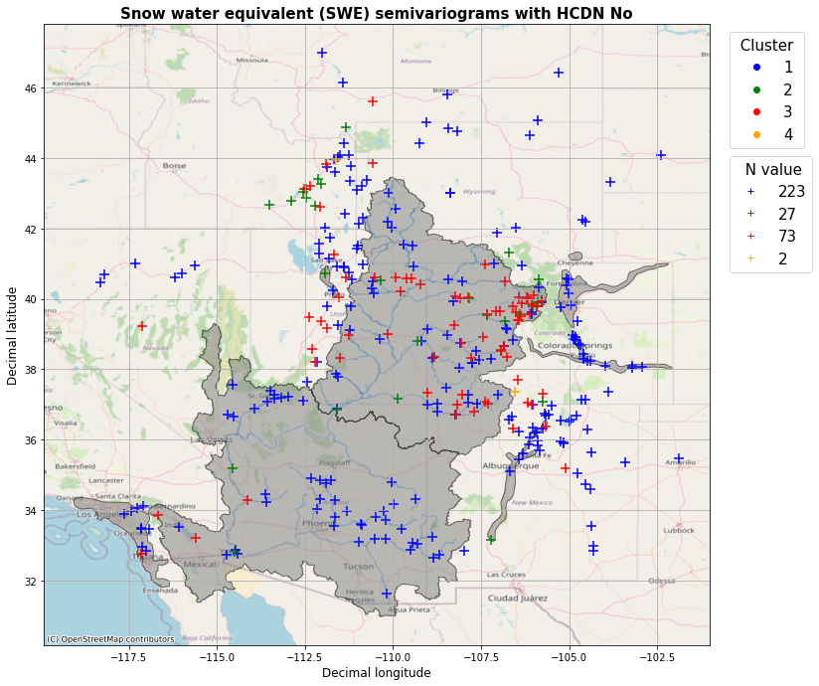

Slide 18
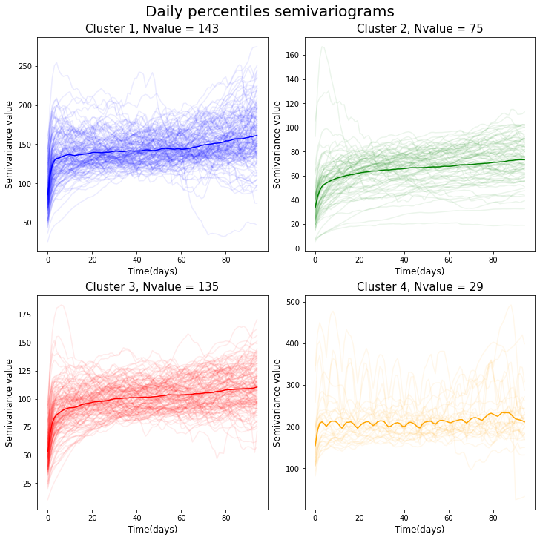
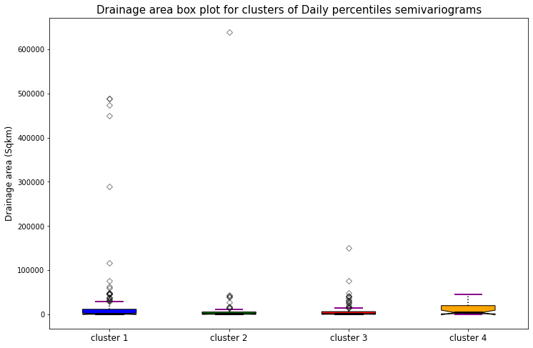
Daily streamflow percentile

Slide 19
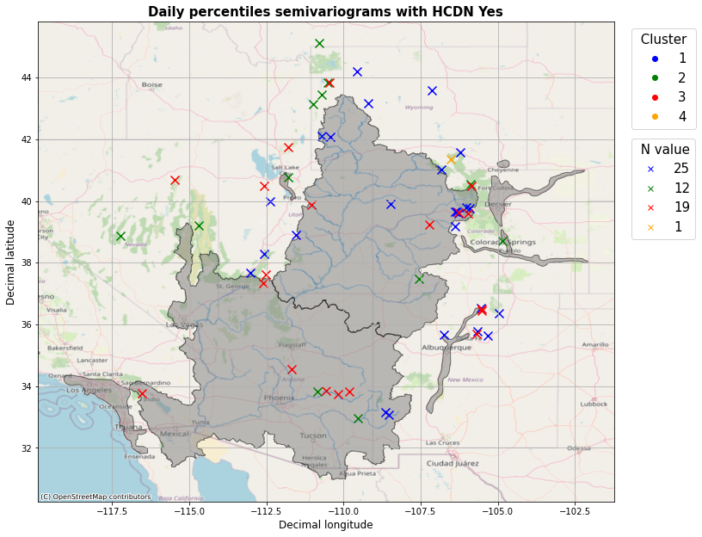

Slide 20
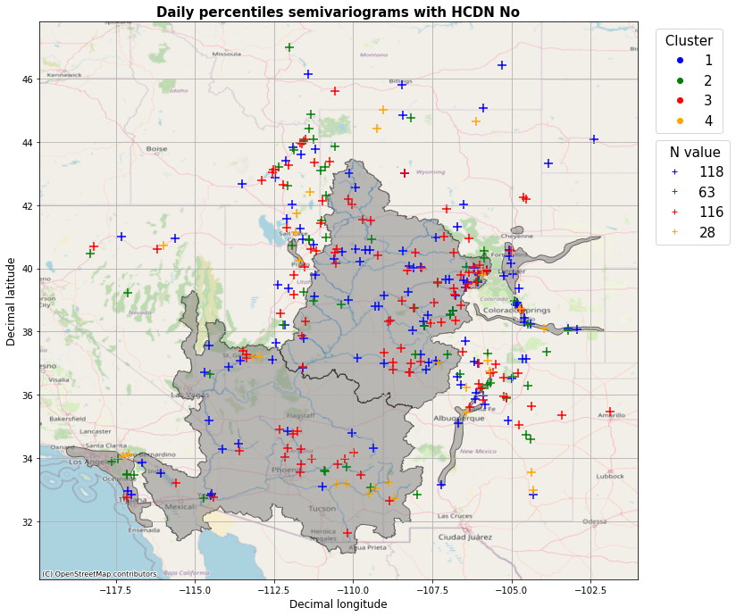

Slide 21
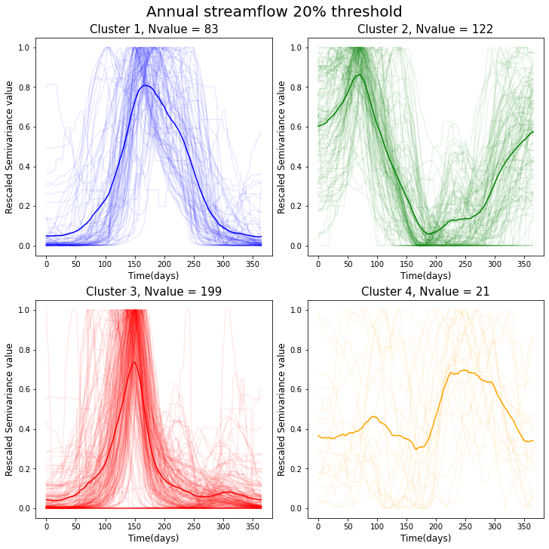
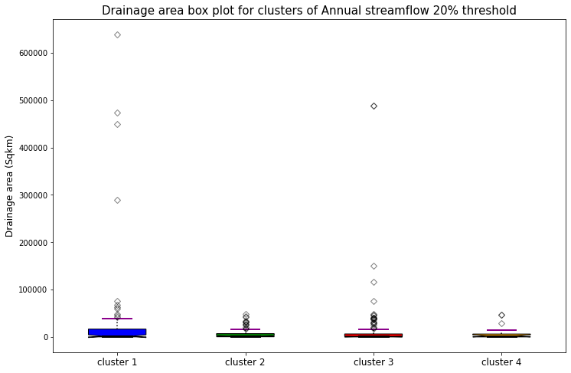
Annual streamflow 20% threshold

Slide 22


Slide 23
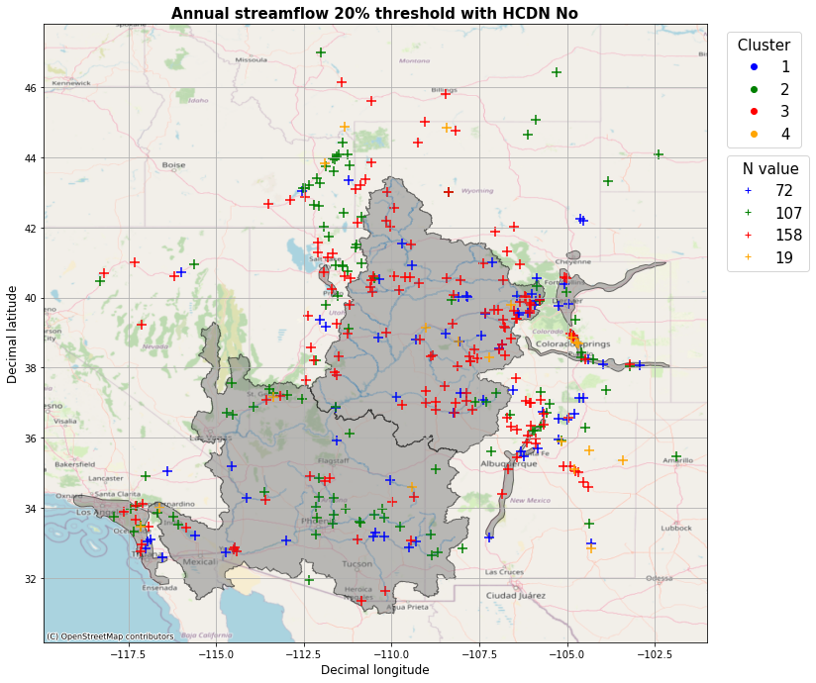

Slide 24
Thank you!
Questions?

Slide 25
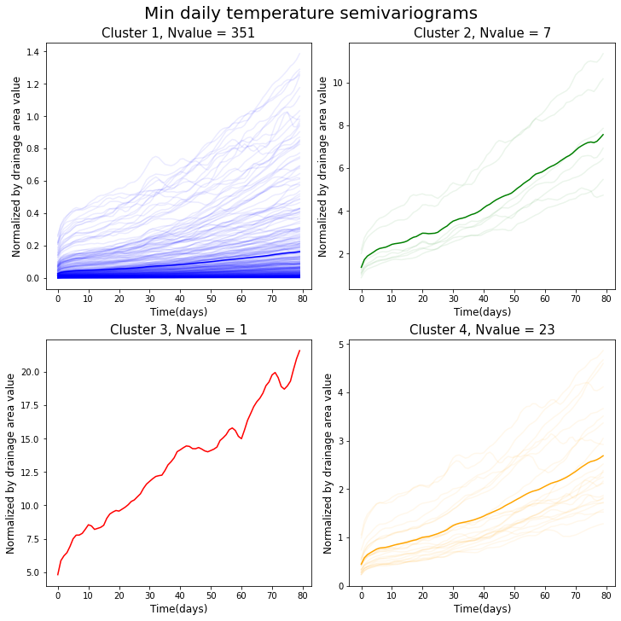
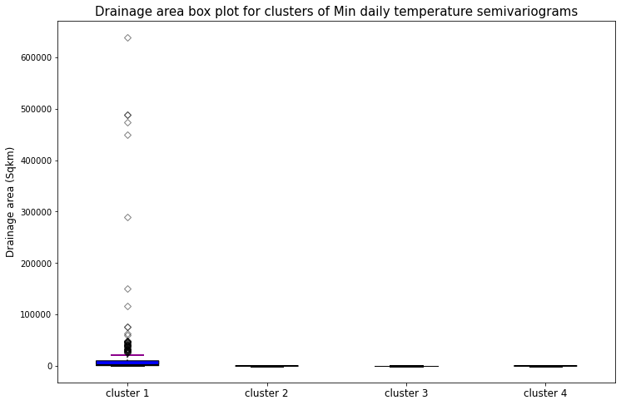

Slide 26
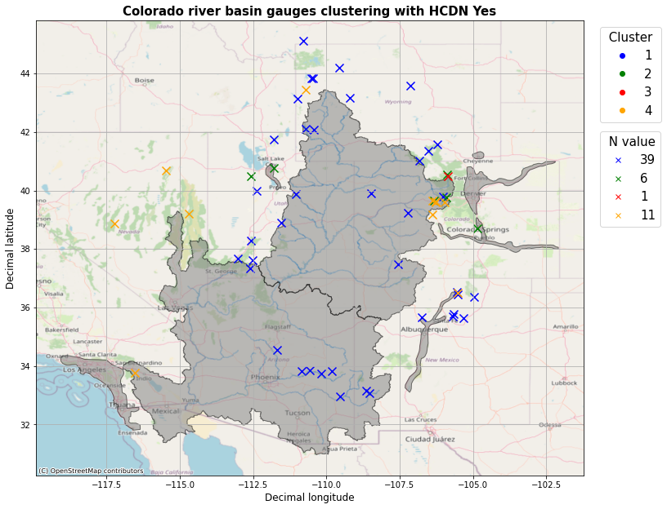

Slide 27
